Slide 1
Do Now
Announcements
Homework 6 due today! 5/7/19. You’re done with homework!
Resubmissions for hw6 will be midnight 5/14/19.
Final exam is next week! 5/14/19*
@andy’s review session: Monday 5/13/19 10am-12pm
@theo’s review session: Friday 5/10/19 2-4pm

Slide 2
CST 370 – ADVANCED ALGORITHMS
Advance Topic Mini-Lesson:
Cryptography

Slide 3
Objectives
You will be able to…
Explain the difference between Symmetric and Asymmetric encryption.
Identify the weaknesses of symmetric key encryption protocols.
Show how to use the Diffie Hellman algorithm to create a shared symmetric key
Explain how asymmetric key encryption protocols work and address the weaknesses of symmetric key encryption.

Slide 4
Terminology
CIphertext vs Plaintext
Cryptography is the art/science of secure communications or sending secret messages.
Encryption is the act of turning a message from it’s readable form (Plaintext) into an unreadable form (Ciphertext).
Decryption is the act of turning Ciphertext into Plaintext.
A Key is some piece of data (a string/password) that’s used to encrypt and decrypt messges.

Slide 5
Ancient Cryptography
Ceasar’s Cipher
The earliest known encryption algorithm is from Julius Ceasar in ancient Rome.
Ceasar’s Cipher is called a substitution cipher. It works by shifting each letter some fixed number of positions down the alphabet.

Slide 6
Ancient Cryptography
Alice and Bob
Alice: Lets used Ceasar’s Cipher with letters shifted by 3
Alice: “KHOOR ZRUOG”
Bob: Ok!
Bob: That reads “Hello World”!

Slide 7
Ancient Cryptography
Weaknesses
This type of encryption algorithm is weak because anyone overhearing the algorithm and the key can decrypt messages.
It’s still weak if they only hear part of it (or even none of it). It’s possible, after seeing enough ciphertext, figure out what algorithm and key was used.

Slide 8
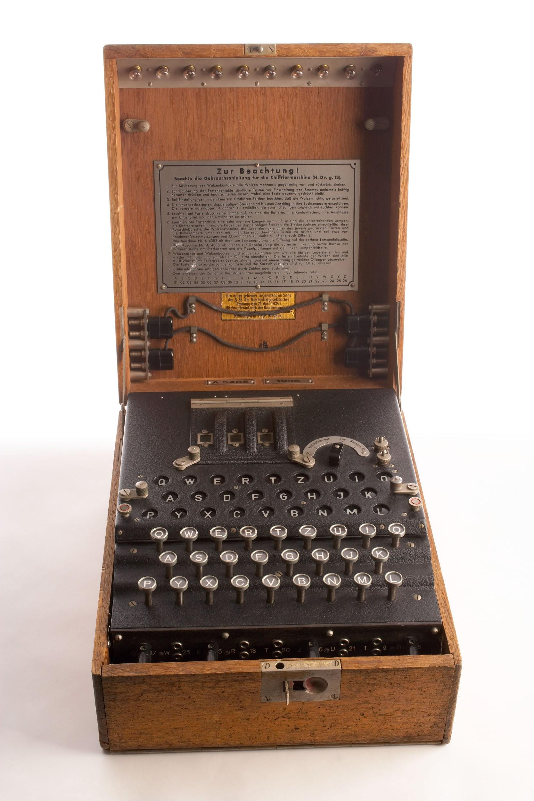
Less-Ancient Cryptography
The Egnima Machine
For most of human history, we used more and more complex substitution ciphers.
For example, the Enigma Machine from WWII
Notes:
In WWII, the German and Axis powers used a encryption algorithm so complex that they just built a machine to do the encryption for them: the Egnima Machine.
The Egnima machine had a complex set of input switches and had a secrete keybook with specific settings for each day.

Slide 9
Less-Ancient Cryptography
Weaknesses
The weaknesses still remained, it just took more time to figure it out.
Once Allied forces got a hold of a working Enigma Machine and looked at enough ciphertext, they broke the code.
Fun fact: Alan Turing, father of modern computer, was a part of the team that broke the code.

Slide 10
Modern Cryptography
The problems we need to address
“A cryptosystem should be secure even if everything about the system, except the key, is public knowledge.” ~ Kerckhoffs
Weaknesses to be addressed.
Alice and Bob need to communicate a shared secret key with each other in a way eavesdroppers can’t figure out.
The secret key needs to be the only way possible to decrypt a message.
Notes:
Petitcolas, Fabien, electronic version and English translation of "La cryptographie militaire

Slide 11
Modern Cryptography
The problems we need to address
Symmetric Key Algorithms are ciphers where one key is used to encrypt and decrypt messages. There’s a lot of that address #2.
Weaknesses to be addressed.
Alice and Bob need to communicate a shared secret key with each other in a way eavesdroppers can’t figure out.
The secret key needs to be the only way possible to decrypt a message.
Notes:
Petitcolas, Fabien, electronic version and English translation of "La cryptographie militaire

Slide 12
Modern Cryptography
The problems we need to address
But what about #1? How can Alice and Bob create a shared secret Key only communicating publically?
Weaknesses to be addressed.
Alice and Bob need to communicate a shared secret key with each other in a way eavesdroppers can’t figure out.
The secret key needs to be the only way possible to decrypt a message.
Notes:
Petitcolas, Fabien, electronic version and English translation of "La cryptographie militaire

Slide 13
Diffie-Hellman Key Exchange
Creating a secret key in public
Whitfield Diffie and Martin Hellman, created an algorithm for publically creating a secret key in 1976.
Using the DH algorithm, Alice and Bob can create a common secret key shared just by the two of them while communicating completely in public!
Notes:
Steps to Diffie Hellman.
1. Alice and Bob agree on two prime numbers: g and p
2. Alice picks a secret number (also prime) ‘a’ and computes g^a mod p. She shares the result, A to Bob.
3. Bob picks a secret number (also prime) ‘b’ and computs g^b mod p. He shares the result B to Alice.
4. Alice computes B ^ a mod p. Bob computes A ^ b mod p.
5. Those two numbers are identical and is the shared secret key K. They can now use the K to encrypt and decrypt messages.

Slide 14
Diffie-Hellman Key Exchange
Algorithm
Alice and Bob agree on two prime numbers: G and P.
Alice picks a secret number a and computes: A = Gª mod P. For example: 2⁵ mod 7 = 32 mod 7 = 4. A = 4.
Bob also picks a secret number b and computes: B = G^{b} mod P.
Alice and Bob share the numbers A and B with each other.
Alice then computes Bª mod P. Bobe computes A^{b} mod P.
Those two results are identical and is the shared secrete key!
Notes:
(Technically british intelligence figured it out in 1969 but that classified until 1997)

Slide 15
Diffie-Hellman Key Exchange
In-Class Example
To calculate Gª mod P. You can use either:
`(G ** a) % P` in python
“(G^a) mod P” in www.wolframalpha.com
Notes:
(Technically british intelligence figured it out in 1969 but that classified until 1997)

Slide 16
Diffie-Hellman Key Exchange
Mathematical Details
This works because both sides end up computing the modulus exponentiation of G: G^{ab} mod P
There is no known fast algorithm to figure out G^{ab} mod P given G^{ab} mod P and G^{ab} mod P when G and P are prime.
This is called the Diffie-Hellman problem or discrete log problem and has survived decades of analysis by mathematicians.
Best known algorithms have exponential time complexity and just try every possible number.
Notes:
Petitcolas, Fabien, electronic version and English translation of "La cryptographie militaire
The reason this works is because both sides have essentially computed the same number: g^ab mod p.
In Number Theory, there’s no known fast algorithm to figure out g^ab mod p given g^a mod p and g^b mod p for prime gs and ps.
This has been called the Diffie Hellman problem or discrete log problem and it’s survived decades of analysis by mathemeticians.

Slide 17
Diffie-Hellman Key Exchange
Weakness
DH still doesn’t enable perfectly secret communications.
Alice and Bob have to trust that the numbers they receive, the A and the B, are actually from Alice and Bob respectively.
If it’s from someone else, then they will have established a shared secret with that someone else instead. This is called a Man in the middle (MITM) attack in cryptography.
Notes:
Petitcolas, Fabien, electronic version and English translation of "La cryptographie militaire

Slide 18
Man in the middle Attack
Example
This time, Alice and Bob are communicating by passing notes in class. They write the node, give it to Derek who passes it to the other person. Derek is curious and wants to read the messages between Alice and Bob.
Notes:
Petitcolas, Fabien, electronic version and English translation of "La cryptographie militaire

Slide 19
Man in the middle Attack
Example
When Alice and Bob share the numbers P and G, Derek writes these down.
Derek:
P = 97
G = 123
Alice:
P = 97
G = 123
Bob:
P = 97
G = 123
Notes:
Petitcolas, Fabien, electronic version and English translation of "La cryptographie militaire
Lets do this again with Alice and Bob. This time, they’re communicating by passing notes in class through a person Derek. Derek is curious and wants to read the messages between Alice and Bob. When they share the p and n, Derek writes it down before passing the note on.
When Alice passes Derek the note with A, he writes that down. *And computes another number D_a* and passes that to Bob. When Bob passes the note with B to Derek, he writes that down *and computes another number D_b* and passes that to Alice. Now alice uses D_a and creates a shared secret K_a and bob uses D_b and creates a shared secret K_b with Derek.

Slide 20
Man in the middle Attack
Example
When Alice passes Derek the note with A, he writes it down. Then uses his own secret number d to compute D and writes that down and passes it to Bob.
Derek:
P = 97
G = 123
d = 9
D = 69
A = 48
Alice:
P = 97
G = 123
a = 10
A = 48
Bob:
P = 97
G = 123
A = 69
A = 48
A = 69
Notes:
Petitcolas, Fabien, electronic version and English translation of "La cryptographie militaire
Lets do this again with Alice and Bob. This time, they’re communicating by passing notes in class through a person Derek. Derek is curious and wants to read the messages between Alice and Bob. When they share the p and n, Derek writes it down before passing the note on.
When Alice passes Derek the note with A, he writes that down. *And computes another number D_a* and passes that to Bob. When Bob passes the note with B to Derek, he writes that down *and computes another number D_b* and passes that to Alice. Now alice uses D_a and creates a shared secret K_a and bob uses D_b and creates a shared secret K_b with Derek.

Slide 21
Man in the middle Attack
Example
When Bob passes Derek the note with B, he writes it down. Then uses his own secret number d to compute D and writes that down and passes it to Alice.
Derek:
P = 17
G = 123
d = 9
D = 69
A = 48
B = 14
Alice:
P = 17
G = 123
a = 10
A = 48
B = 69
Bob:
P = 17
G = 123
b = 19
B = 14
A = 69
B = 69
B = 14
Notes:
Petitcolas, Fabien, electronic version and English translation of "La cryptographie militaire
Lets do this again with Alice and Bob. This time, they’re communicating by passing notes in class through a person Derek. Derek is curious and wants to read the messages between Alice and Bob. When they share the p and n, Derek writes it down before passing the note on.
When Alice passes Derek the note with A, he writes that down. *And computes another number D_a* and passes that to Bob. When Bob passes the note with B to Derek, he writes that down *and computes another number D_b* and passes that to Alice. Now alice uses D_a and creates a shared secret K_a and bob uses D_b and creates a shared secret K_b with Derek.

Slide 22
Man in the middle Attack
Example
Alice uses what she thinks is B to compute the shared key K_a.
Bob uses what he thinks is A to compute the shared key K_b.
Derek:
P = 17
G = 123
d = 9
A = 48
B = 14
K_a = 79
K_b = 30
Alice:
P = 17
G = 123
a = 10
B = 69
K_a = 79
Bob:
P = 17
G = 123
b = 19
A = 69
K_b = 30
Notes:
Petitcolas, Fabien, electronic version and English translation of "La cryptographie militaire
Lets do this again with Alice and Bob. This time, they’re communicating by passing notes in class through a person Derek. Derek is curious and wants to read the messages between Alice and Bob. When they share the p and n, Derek writes it down before passing the note on.
When Alice passes Derek the note with A, he writes that down. *And computes another number D_a* and passes that to Bob. When Bob passes the note with B to Derek, he writes that down *and computes another number D_b* and passes that to Alice. Now alice uses D_a and creates a shared secret K_a and bob uses D_b and creates a shared secret K_b with Derek.

Slide 23
Man in the middle Attack
Example
Whenever Alice passes an encrypted message to Derek. He can decrypte it with K_a, read it, re-encrypt it with K_b, then pass it to Bob. Alice and Bob will think they’re communication is secure but Derek can read everything.
Alice:
...
K_a = 79
Derek:
...
K_a = 79
K_b = 30
Bob:
...
K_b = 30
Notes:
Petitcolas, Fabien, electronic version and English translation of "La cryptographie militaire
This marks the biggest weakness with Diffie Hellman Key Exchange. There’s no way of verifying who sent the messages.
Lets do this again with Alice and Bob. This time, they’re communicating by passing notes in class through a person Derek. Derek is curious and wants to read the messages between Alice and Bob. When they share the p and n, Derek writes it down before passing the note on.
When Alice passes Derek the note with A, he writes that down. *And computes another number D_a* and passes that to Bob. When Bob passes the note with B to Derek, he writes that down *and computes another number D_b* and passes that to Alice. Now alice uses D_a and creates a shared secret K_a and bob uses D_b and creates a shared secret K_b with Derek.

Slide 24
Asymmetric Key Encryption
Solving the Man-in-the-middle weakness
Asymmetric Key Encryption relies on the fact that there’s two separate keys per person: a Public key and a Private key.
A message encrypted with Public Key K can only be decrypted by Private Key k and vice versa.
Alice and Bob now only share their public keys and keep their private keys secret.
Notes:
Petitcolas, Fabien, electronic version and English translation of "La cryptographie militaire

Slide 25
Asymmetric Key Encryption
Steps - Key Establishment
Alice and Bob agree on the asymmetric key encryption algorithm to use.
Alice creates a public/private key pair A & a and shares A publicly.
Bob does the same with his key pair B & b.
Notes:
(Technically british intelligence figured it out in 1969 but that classified until 1997)

Slide 26
Asymmetric Key Encryption
Steps - Encrypting a Message
Bob takes the message he wants to share M and first encrypts it with Alice’s public key A to get A(M).
He then encrypts it again with his private key b to get b(A(M)).
He passes the ciphertext b(A(M)) through Dan to Alice.
Notes:
(Technically british intelligence figured it out in 1969 but that classified until 1997)

Slide 27
Asymmetric Key Encryption
Steps - Decrypting a Message
Alice receives the note with b(A(M)) and first decrypts it with Bob’s public key B to get: A(M)
Alice then decrypts it again with her private key a to get M!
She crafts a response. Re-encrypt it with Bob’s public key, then with her private key, and sends off a(B(M))
Notes:
(Technically british intelligence figured it out in 1969 but that classified until 1997)

Slide 28
Asymmetric Key Encryption
Layers of encryption
Encrypted with Bob’s private key.
Inner layer of encryption ensures that the message is for Alice: If Alice’s private key can decrypt it, it must be encrypted by her public key.
Encrypted with Alice’s public Key.
“This is From Bob to Alice”

Slide 29
Asymmetric Key Encryption
Layers of encryption
Encrypted with Bob’s private key.
Outer layer of encryption ensures that the message came from Bob: If Bob’s public key can decrypt it, it must be encrypted by his private key.
Encrypted with Alice’s public Key.
“This is From Bob to Alice”

Slide 30
Asymmetric Key Encryption
Thwarting the man in the middle
Encrypted with Bob’s private key.
Derek can not figure out what Bob and Alice are saying because the private keys are never shared.
Encrypted with Alice’s public Key.
“This is From Bob to Alice”

Slide 31
Asymmetric Key Encryption
Thwarting the man in the middle
He can decrypt the outer layer with Bob’s public key but will be left with ciphertext that he can’t decrypt.
Which means Derek can’t be sure it was from Bob either!
Encrypted with Alice’s public Key.
“This is From Bob to Alice”

Slide 32
Asymmetric Key Encryption
Mathematical Details
One of the earliest asymmetric key encryption algorithms is called RSA and from the late 1970s.
RSA uses the idea that there’s no fast algorithm for solving prime factorization.
If I multiply two large prime numbers P and Q, It’s very hard to figure out what P and Q are if you don’t know at least one.
This is called a one-way function, it’s easy to verify but very hard to reverse the operation.

Slide 33
Modern Cryptography
Practical uses
Asymmetric Key Algorithms like RSA address both weaknesses discussed earlier but are slower than symmetric key algorithms.
In practice, for time-sensitive use cases like messaging, RSA is used to verify the communicating parties and Diffie-Hellman is used to create a shared key for the session.

Slide 34
Modern Cryptography
Practical uses
Bitcoin and cryptocurrency uses an asymmetric encryption.
SSH, https, and encrypted messaging like WhatsApp, iMessage, Telegram, and Messenger’s secret conversations uses asymmetric key encryption to verify connections and Diffie-Hellman to establish a secret key for the session.
iMessage specifically uses 1024-bit RSA (the prime numbers selected are over 150 digits long!).

